Slide 1
Enterprise Resource Planning
Deliverable 2
Group Members
Kritin Kondru
Kimaya Gado
Romit Zunjarro
Bhushan Navgire
Gowthami Mittameeda

Slide 2
Product Backlog, Sprint Backlog and User Stories
SPRINTS
Sprint 1 - Web Module and Dash Board Module | Status: Completed
Sprint 2 – Human Resource | Status: Completed
Sprint 3 – Inventory Management | Status: In progress
Sprint 4 – Sales Module | Status: Not Started

Slide 3

Sprint [1] | Login/Sign-up and Dashboard Module Status : Completed
In the 1st sprint we completed login/sign-up and dashboard module.

Slide 4
Sprint [2] | Employee Module Status : Completed
Being an authentic user, product owner must be able to manage employee’s. Managing employee’s include:
Adding a new employee
Deleting an existing employee
Updating information of existing employee
The employee information contained in the system include:
First name and Last name of Employee.
Position on which he is going to be appointed.
Manager which he is going to work under.
Working Hours.
Salary of Employee.
Contact Details of Employee.

Slide 5
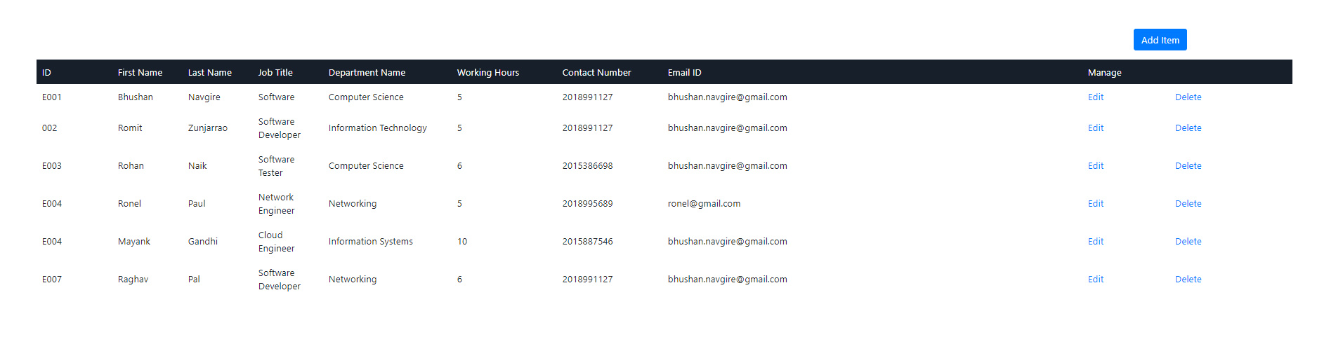
Screenshot 1

Slide 6
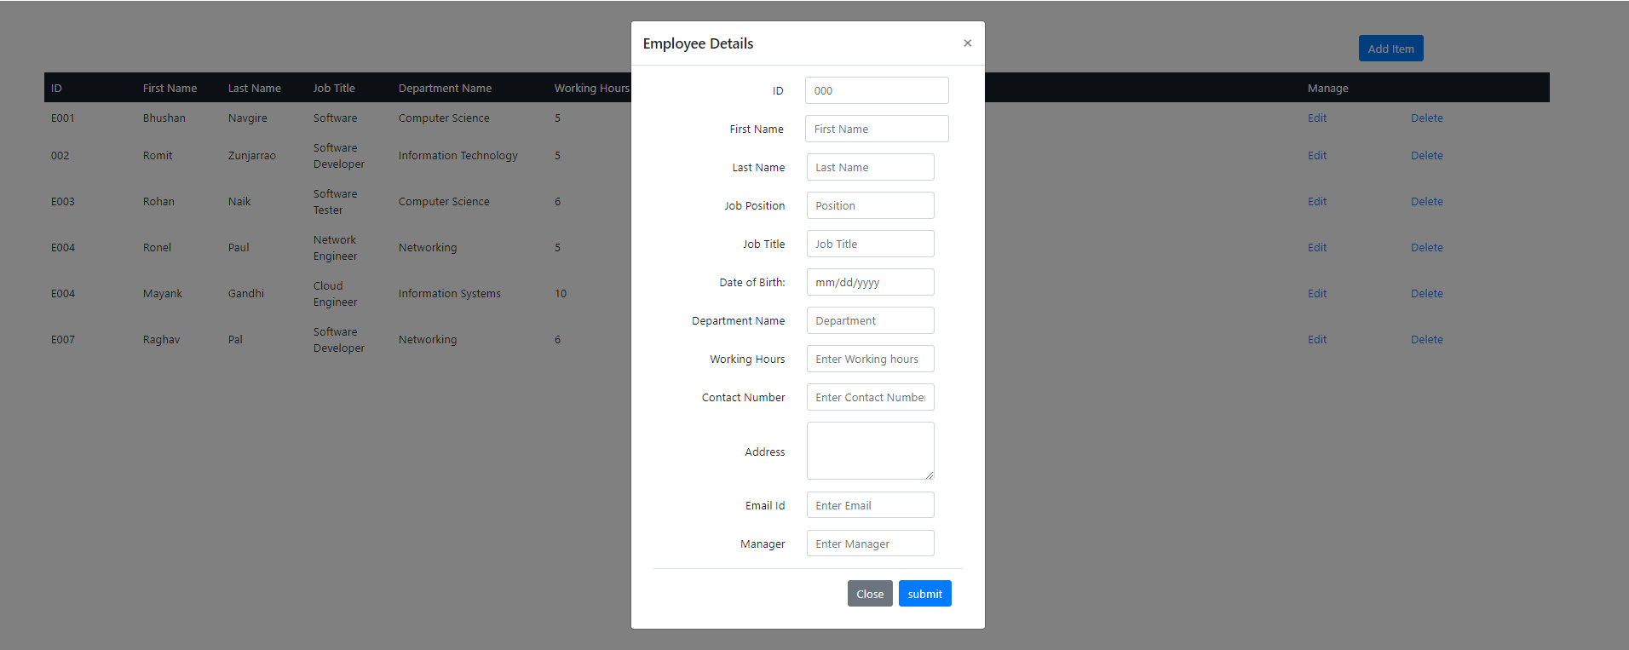
Screenshot 2

Slide 7
Product Backlog
User Story [Status: completed] :
As an authentic user, I should be able to add employee into the system.
User Story[Status: completed]:
As an authentic user, I should be able to delete employee from the system.
User Story[Status: completed]:
As a authentic user, I should be able to view the list of employees.
User Story[Status: completed]:
As a registered user, whenever there need’s to be change in the employee details, I should be able update the information in system.

Slide 8
Upcoming Sprint’s
Sprint 3: User Story[Status: not yet started]:
As a user, I should be able to manage Inventory related information.
Sprint 4:User Story[Status: not yet started]:
As a user, I should be able to manage sales record .

Slide 9
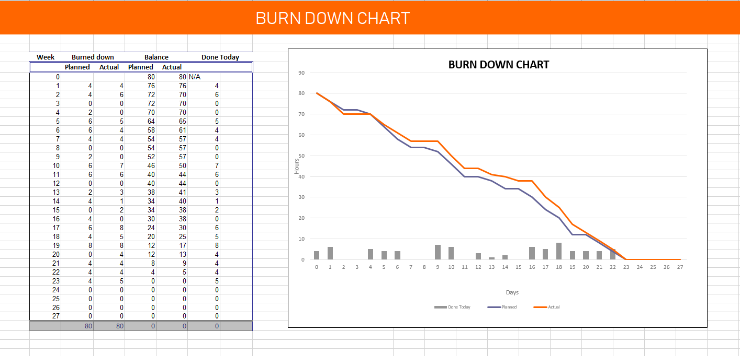

Slide 10
Test Cases
No. | Test Cases | Type- Negative/ Positive Test Case
1 | Verify if user is logged in with valid credentials, then he gets to see all functional modules | Positive
2 | Verify if user enters wrong credentials, then he should no be able to access employee module. | Negative
3 | Verify when user clicks on HR module, he get to see list of employee. | Positive
4 | Verify if user can access the add functionality | Position
5 | Verify if user click’s on add, is redirected to Add employee form that contains required field’s. | Positive
6 | Verify if user is able to use Update and Delete functionality from the Employee present in the List. | Positive
7 | Verify if on clicking update, user is redirected to Employee form with existing information and should be able to update it. | Positive
8 | Verify if user get’s to see updated list after performing add, update and delete operation | Positive

Slide 11


